Slide 1
Warping Feature Usage Through GDT
October 2016

Slide 2
Overview
Optics Input
Coordinate Buffer Creation
Warp Feature through GDT

Slide 3


Input from Optics Engineer
Grid Data from Optics Engineer
Source Grid
Source Image grid to Destination Image grid mapping data
IrisWarpGen Tool
Destination Grid
Notes:
* input file format
The input file should be provided as a ASCII text file.
The first line in the file will contain 4 integer values, respectively :
image_width image_height grid_column_nb grid_row_nb
The following lines, one for each point of the grid, i.e. (grid_column_nb * grid_row_nb) lines, will each contain 4 numbers (integers or floats), respectively :
source_point_x source_point_y target_point_x target_point_y
* example input file 100x60 image, with grid of 3x2 points :
100 60 3 2
10 10 8.2 9.1
30 10 32.65 9.8
50 10 48.63 9.25
10 30 8.6 27.2
30 30 31.6 28.4
50 30 47.95 27.93
the grid coordinates should be "ordered" consistently, e.g. scanning grid points left to right, top to bottom.

Slide 4




Warping Work flow
Coordinate Buffer Creation
UI Application
ui.core.gdt
Optics data:
Or
Tool input format
Enable the warp feature in GDT(Refer Slide 4 and 6)
Manual: copy-paste + minor editing
conversion
tools
Gfx Manager
raw coordinate buffer (.pcm)
grid_to_coord.exe
Include the co-ordinate buffer in “hmi_gfx_mgr02_warp_tables.cfg “
Iris Driver
Compressed
Coordinate buffer
gen_warp_header.exe
Notes:
This buffer specifies for each pixel of the displayed « target » image, the coordinates (as floating-point numbers) where to get the pixel color from in the source image.
The final color for each pixel will thus be computed from filtering the pixels in the neighborood of these coordinates in the source image.
Nearest point, bi-linear or anisotropic filtering can be selected.

Slide 5
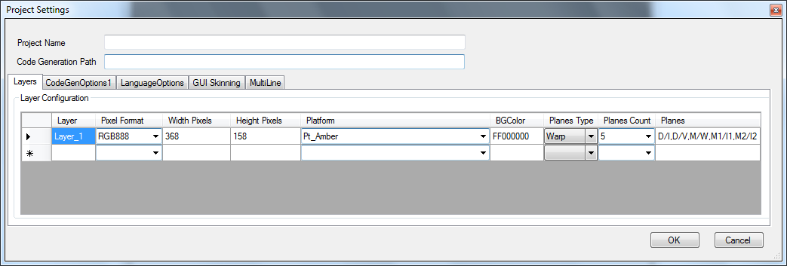
Usage through GDT –Warping through Display Controller
For Warping through Display Controller, the Plane Type in the Project Settings of the GDT must be selected as Warp.
By default the coordinate buffer index value for this is generated as ‘0’.
Notes:
1. The Generated Warping buffer from IrisWarpGen Tool will be included to GDT through hmi_gfx_mgr02_warp_tables.cfg file. The reference cfg can be found in the “\ui.core.gdt\hmi.gfx.manager.02\cfg”.
2. The Warping functionality through Display Controller or Blit engine can be achieved.
The GDT will decide the type of warping based on the warp input to tool.

Slide 6
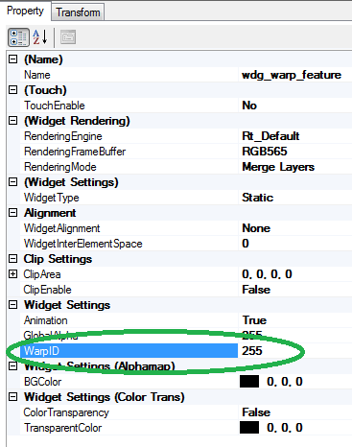
Usage through GDT –Warping through Blit Engine
For Warping using Blit Engine, the warp id of the widget need to be set other than the default value(i.e 255).
The GDT will look for the Coordinate buffer with index value mentioned in the Warp id of widget property.
Notes:
The below API is used to set the coordinate buffer dynamically by the user.
GUI_GFX_MGR_ERROR_CODE_T hmi_gfx_mgr02_layout_set_warping_table(GFX_MGR02_ANIM_ELEM_ID p_elem_id, MML_GDC_WARP_PARAM* p_warp_param, UINT8 * p_warp_data, UINT8 p_force_update)

Slide 7
For Further Details
Please refer the below document for further details.
1. The warping tool usage details available in the below path.
http://hub.visteon.com/enterProj/cgi-bin/loginep.pl?http://enterproj.visteon.com/enterproj/spm_proj_docs_list?p_proj_id=12027&p_attachment_id=1178988&p_doctype=PROJECT&p_show=ALL#D1178988
2. Kepler2 Graphics Characterization
http://hub.visteon.com/enterProj/cgi-bin/loginep.pl?http://enterproj.visteon.com/enterproj/spm_proj_docs_list?p_proj_id=12027&p_attachment_id=1236697&p_doctype=PROJECT&p_show=ALL#D1236697

